Slide 1
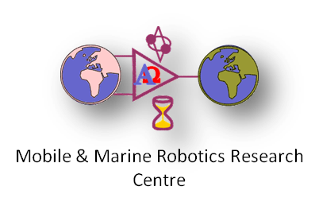
Ground Station Design and Optimization for Airborne Wind Energy
PhD Research Project:
Supervisor: Dr. Daniel Toal
Student: Mahdi Ebrahimi Salari

Slide 2
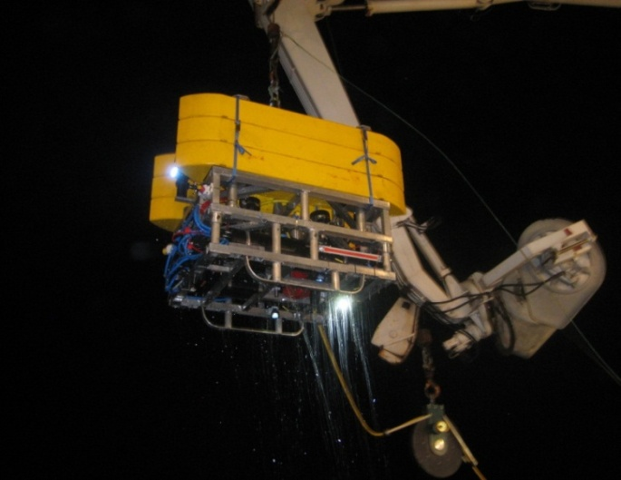
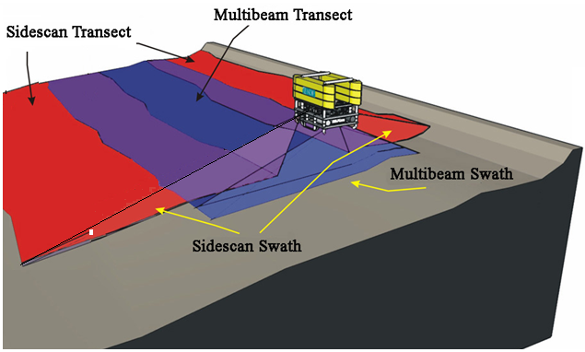
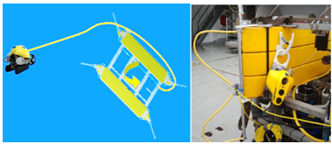
University of Limerick Mobile and Marine Robotic Research Centre (MMRRC)
Established in 2000 by Dr. Daniel Toal
Development of marine robotics within the island of Ireland.
Technologies:
Smart ROV Systems
ROV Latis
Ocean Rings
Precision Navigation Autopilots
Sonar Technology
Airborne Wind Energy
Etc.

Slide 3
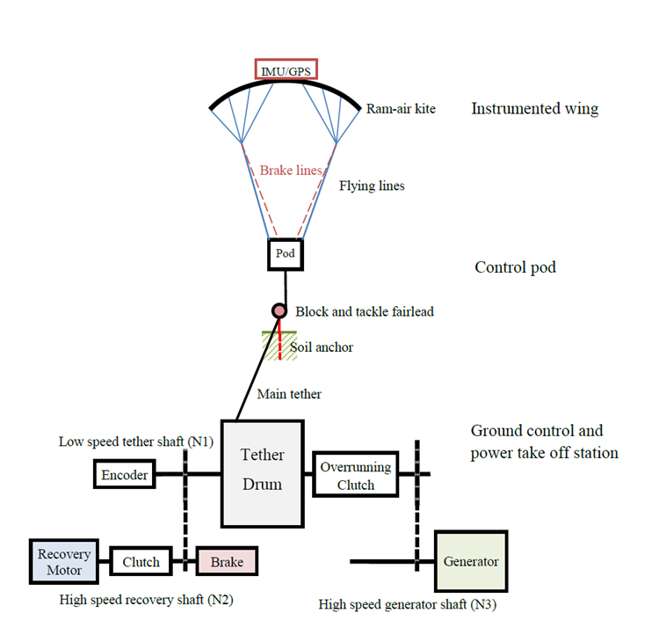
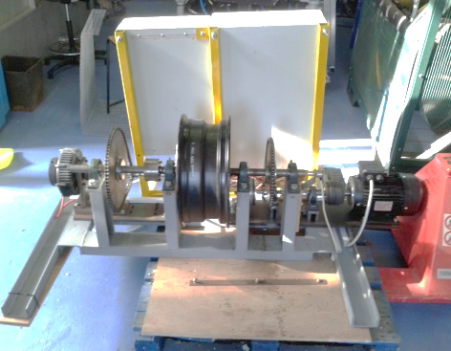
Airborne wind energy at MMRRC
Joseph Coleman
Distributed Control System and Novel Power Take Off Method for Pumping-Mode Airborne Wind Energy
PhD thesis, University of Limerick, Oct.2014
Generator
Generator
Brake
Clutch (obscured)
Overrunning clutch
Tether drum
Recovery motor

Slide 4
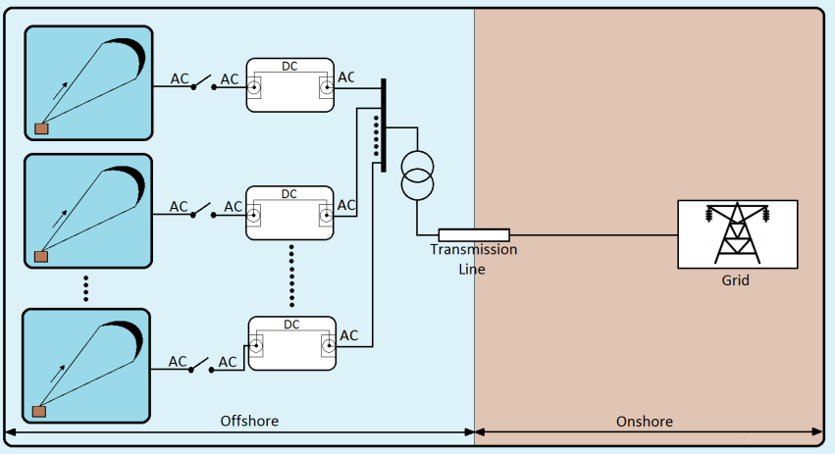
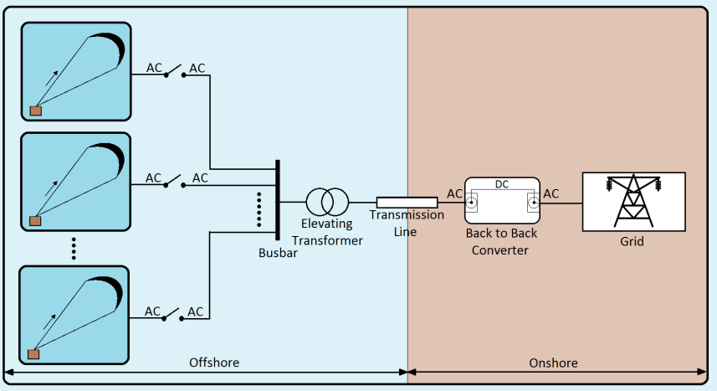
Project Description
Project objective: Integration of AWE farms in compliance with transmission and distribution system operator grid codes
Conventional approach to interconnect offshore generators:
High expenses of Installation, Repair and maintenance for off-shore systems
Direct interconnection technique
More economical
More reliable

Slide 5
Research Methodology
Laboratory Rig
Three 1.5 kW permanent magnet synchronous generators which are coupled with three phase induction motors as prime movers
Three variable frequency drives for controlling the speed of prime movers (3ph induction motors)
NI Compact RIO along with NI LabVIEW as data acquisition and control system

Slide 6
Research Methodology
Laboratory Rig
Applications:
Modelling of non-reversing pumping mode AWE
Investigate different synchronization and interconnection strategies
Modelling of small scale AWE farms and investigate interaction between AWE units and grid

Slide 7
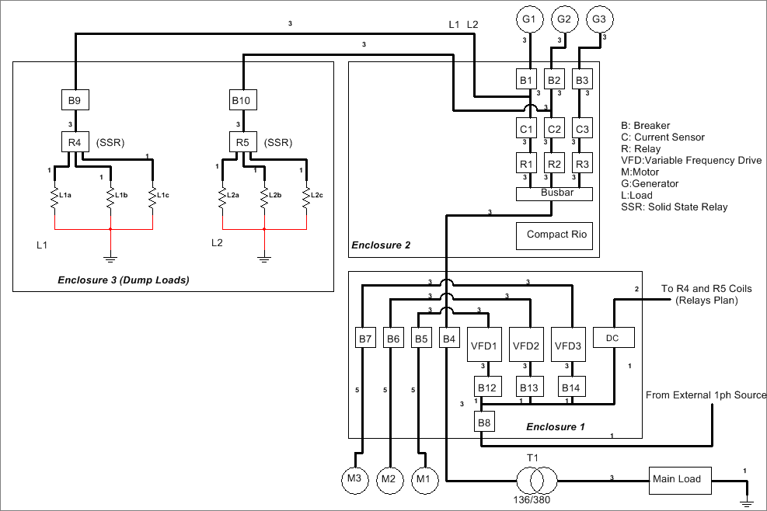
Research Methodology
Laboratory Rig

Slide 8
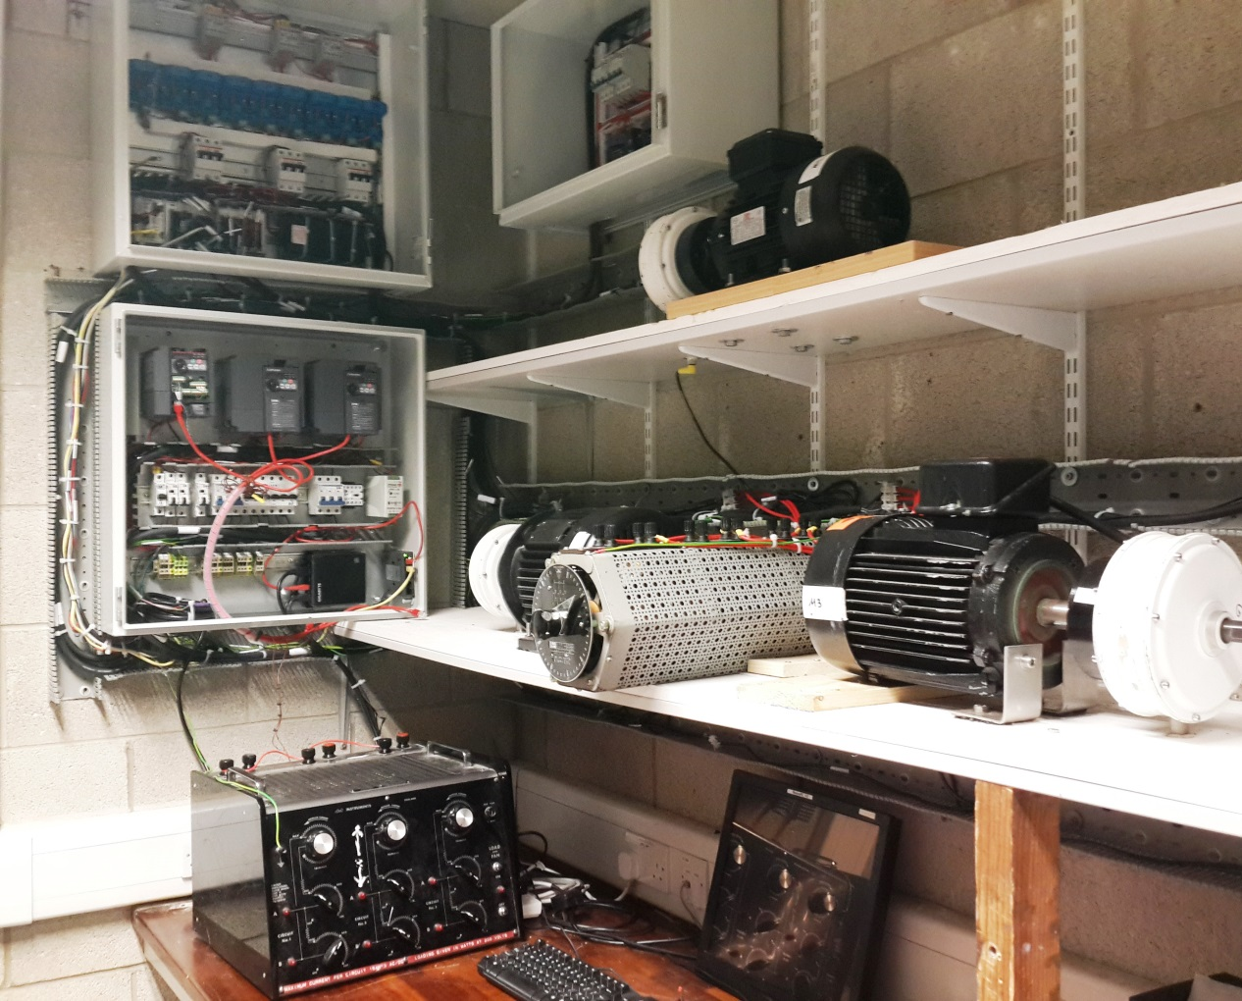
Research Methodology
Laboratory Rig

Slide 9
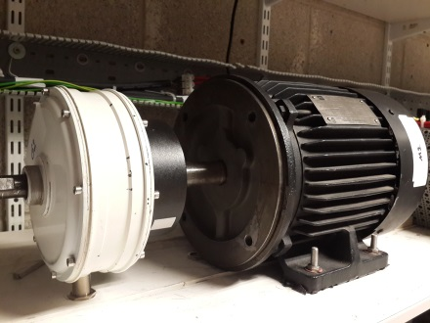
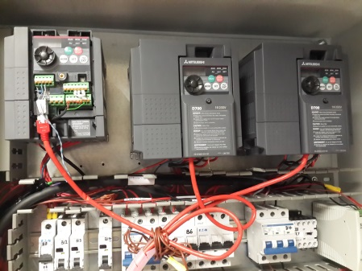
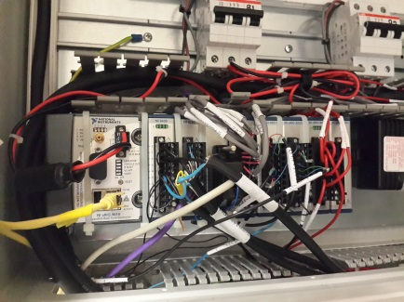
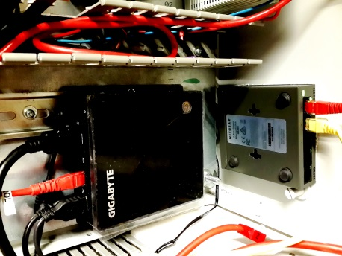
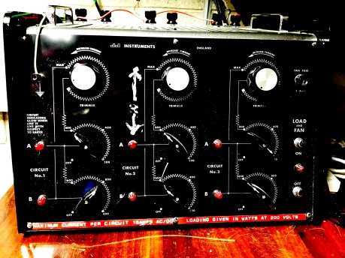
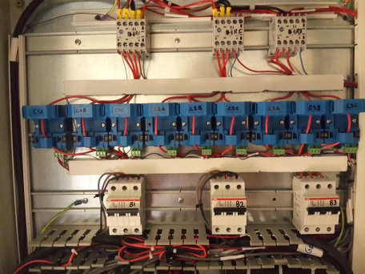
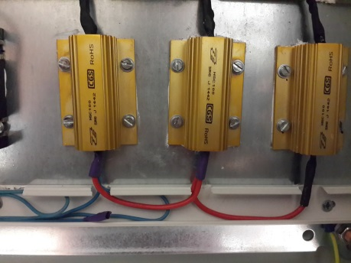
Research Methodology
Laboratory Rig
Coupled Motor-Generator
Variable Frequency Drives (VFDs)
NI CompactRIO
Computer & Network Switch
Main Load
Current Sensors
Dump Loads

Slide 10
Research Methodology
Simulation
Control approaches to increase system efficiency
AWE farms in large scale
Grid interconnection of AWE farms
Transmission systems

Slide 11
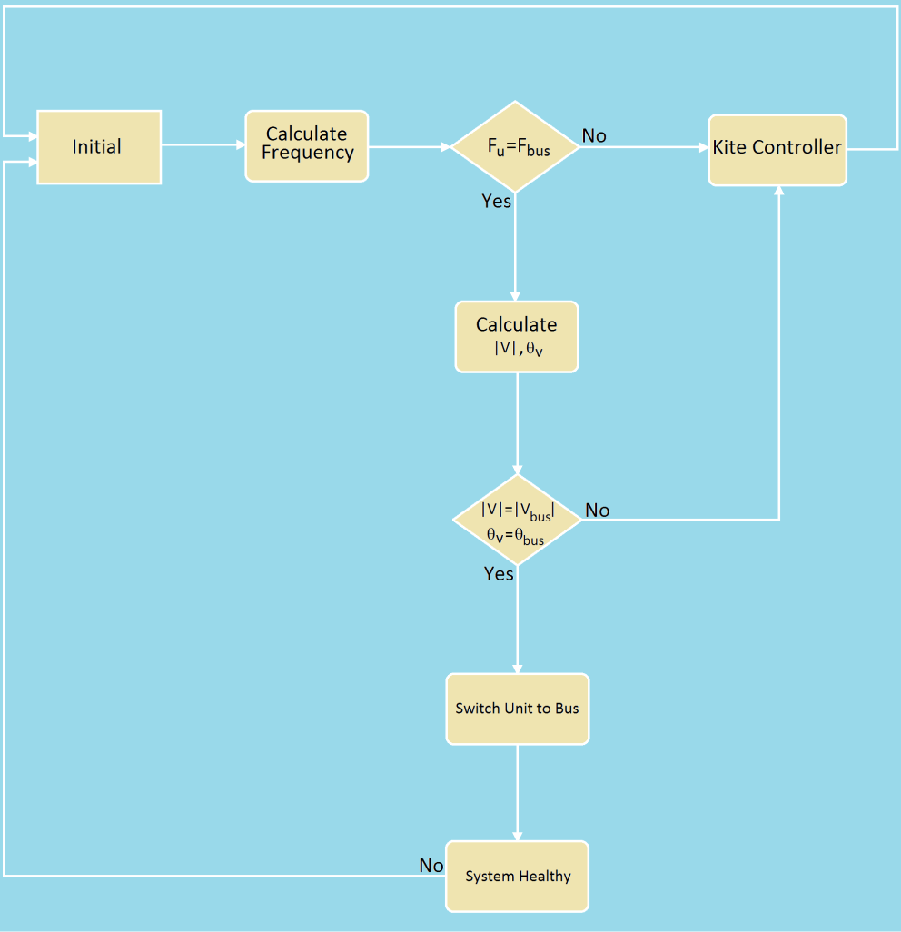
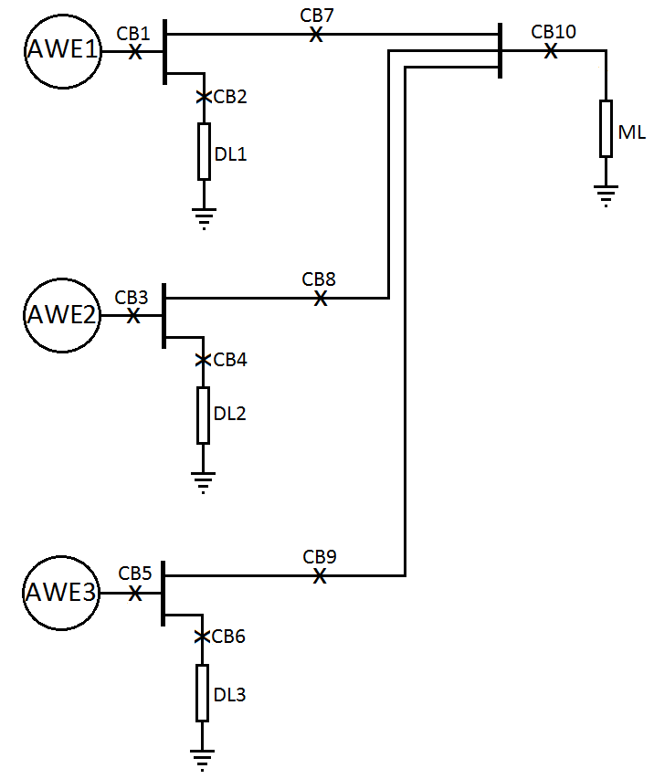
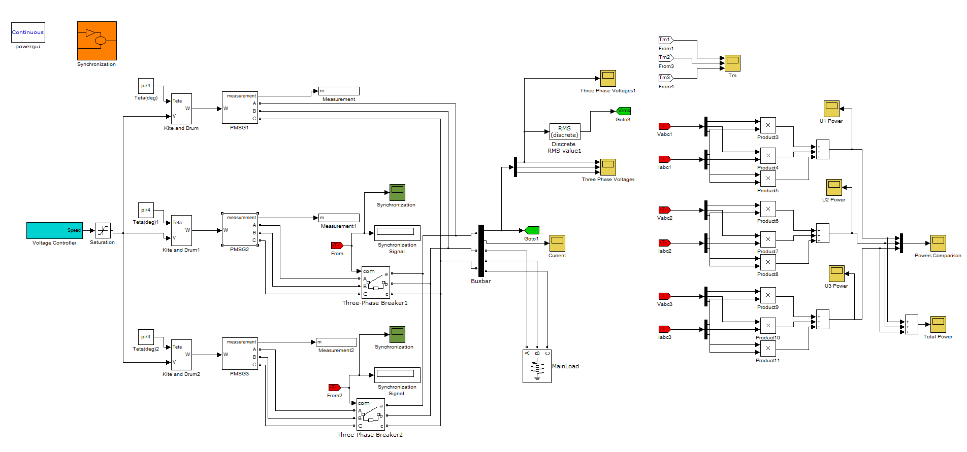
Research Methodology
Simulation
Simulation of small AWE farm to investigate direct interconnection

Slide 12
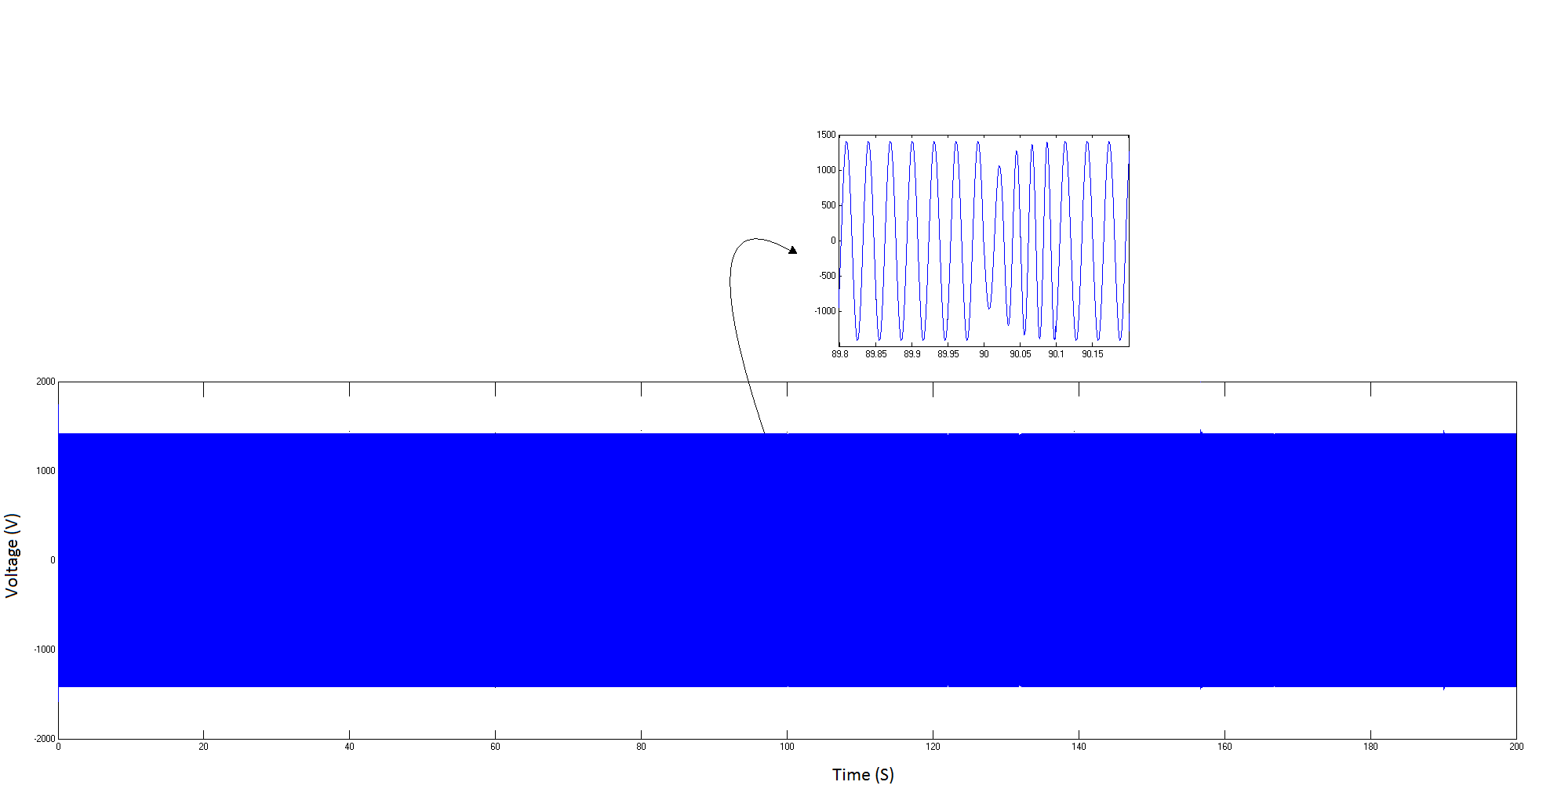
Research Methodology
Simulation
The generated power of direct interconnected AWE farm
The input torque of each generator
Generated voltage

Slide 13
Publications
Mahdi Ebrahimi Salari, Joseph Coleman, Gerard Dooly, Daniel Toal, “Direct Interconnection of Offshore Airborne Wind Energy Systems”, MTS/IEEE Oceans’15 conference, Washington , DC , October 19- 22, 2015
Mahdi Ebrahimi Salari, Joseph Coleman, Daniel Toal, “Airborne Wind Energy- A Review”, 3rd ENEFM2015 Conference , Oludeniz, Turkey, October 19-23, 2015

Slide 14
Plan for the future
Laboratory rig:
Modelling of small AWE farms with the aim of exploring the electromechanical dynamics of interconnected AWE systems
Testing different interconnection methods to find a reliable and economical approach.
Simulation models:
Modelling of offshore AWE farms in coordination with laboratory rig.
Modelling of airborne wind energy farms in large scales
The development of ground station will be investigated to improve system performance.
Secondments:
May and June 2017, 2 months at Skysails to get familiar with industrial airborne AWE systems.
March and April 2018 , 2 month at ALU-FR will take place to work on the modelling and control system of rigid wing AWE systems for interfacing of airborne system to the multiple AWE generator rig.

Slide 15
Conclusions
Direct interconnection would be an appropriate technique to reduce the repair and maintenance cost of offshore AWEs
Laboratory rig and computer simulations are used to design and test different synchronization and control approaches for the interconnection of off-shore AWEs

Slide 16
Thank you for listening

